Slide 1
Kimonos and Yukata
3rd grade

Slide 2
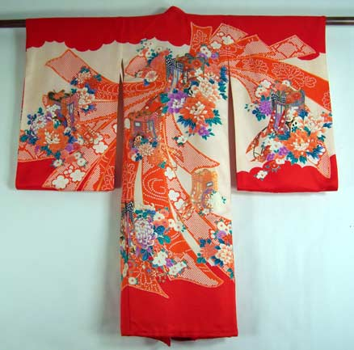
Beautiful silk kimonos are worn for formal ceremonies such as weddings and tea ceremonies.

Slide 3
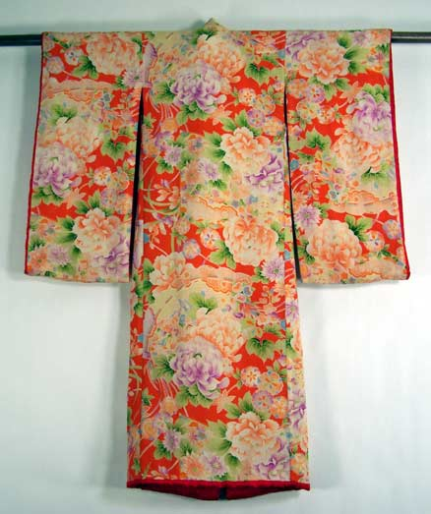
Woman’s kimono

Slide 4
Formal uchikake kimono, worn at wedding reception
Source: http://kimonorentals.com/gallery_uchikake.htm

Slide 5
Japanese tea ceremony
Source: http://www.shibuiswords.com/japantea.htm

Slide 6
Obi (sash/belt)
Source: http://www.etsy.com/blog/en/2009/etsy-world-tour-seijin-shiki-japanese-coming-of-age-day/

Slide 7
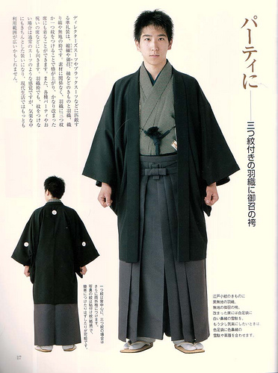
A groom may wear a kimono and haori (jacket) in a traditional Japanese wedding

Slide 8
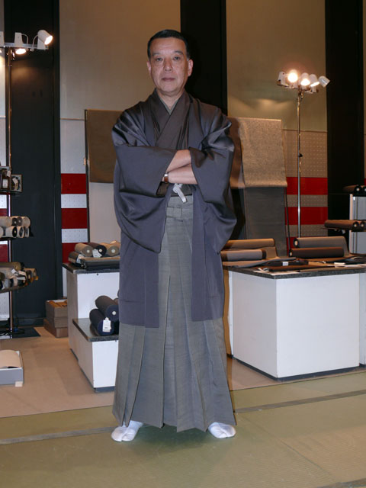

Slide 9
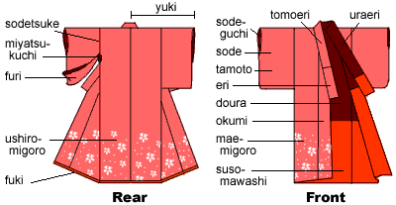
Parts of the kimono

Slide 10
Yukata look like kimonos. They are made of cotton and are worn in summer.
Source: www.akiodesigns.com

Slide 11
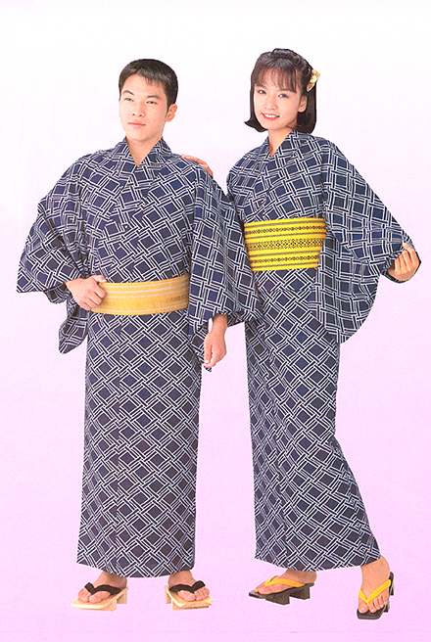
Men and women wear yukata

Slide 12
Yukata are also worn during visits to traditional Japanese inns (ryokan) or after bathing.
Source: http://japan-articles.japanican.com/en/articles/20090128Ryokan_FAQ.html

Slide 13
Art Kimono “Ohn/Fuji and Burning Clouds’ by Itchiku Kubota
Source: Itchiku Kubota Art Museum, Japan

Slide 14
Art kimono by Itchiku Kobota

Slide 15
Art kimono by Itchiku Kobota

Slide 16
Art kimono by Itchiku Kobota

Slide 17
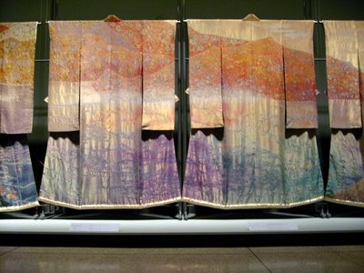
Art kimono by Itchiku Kobota

Slide 18
Art kimono by Itchiku Kobota

Slide 19
Art kimono by Itchiku Kobota

Slide 20
Art kimono by Itchiku Kobota

