Slide 1
Alexander Calder Wire Portraits
5th grade

Slide 2
Calder’s Portraits, sculpted around 1929-30

Slide 4
Shadows cast by portraits

Slide 5
Calder’s self-portrait, 1968.

Slide 6
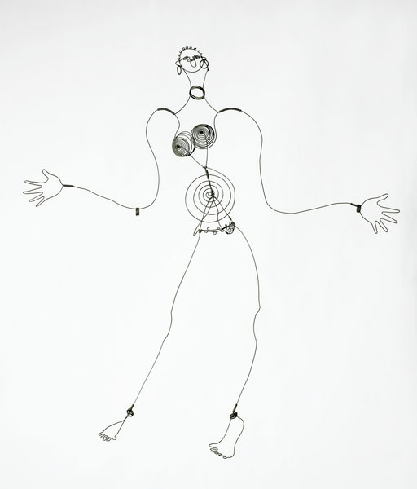
Portrait of entertainer Josephine Baker

Slide 7
Kiki de Montparnasse, 1930

Slide 8
Amedee Ozenfant, 1930

Slide 9
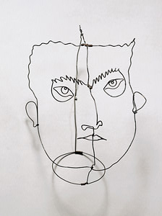
Edgar Varese

Slide 10
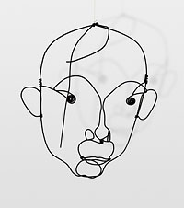
Portrait of famous artist Joan Miro, 1930

