Slide 1
Monet’s Garden
Giverny, France
2nd grade

Slide 2
Who is Claude Monet
French
Born in 1840
Learned to draw cartoons!
Painted in Paris
Bought a house with a pond in Giverny, France
Painted with cool colors: pond and water lillies
Died in 1923

Slide 3
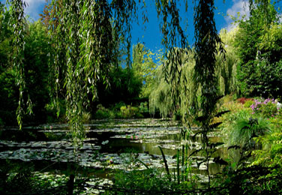
Monet’s pond

Slide 4
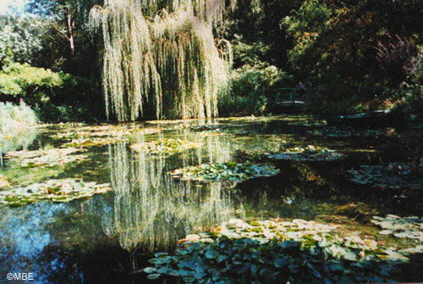
Can you see the Japanese bridge?

Slide 5
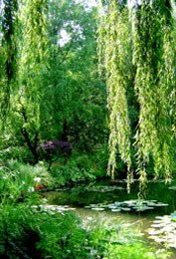
Weeping Willow Tree

Slide 6
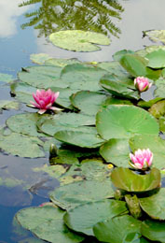
Water Lillies

Slide 7
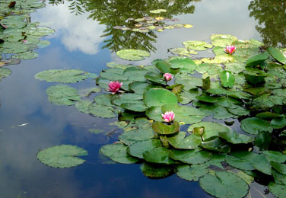
Water Lillies

Slide 8
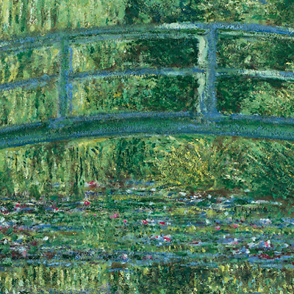
Monet’s painting of his pond

