Slide 1
Foil Relief – Name Art
6th grade – high school

Slide 2
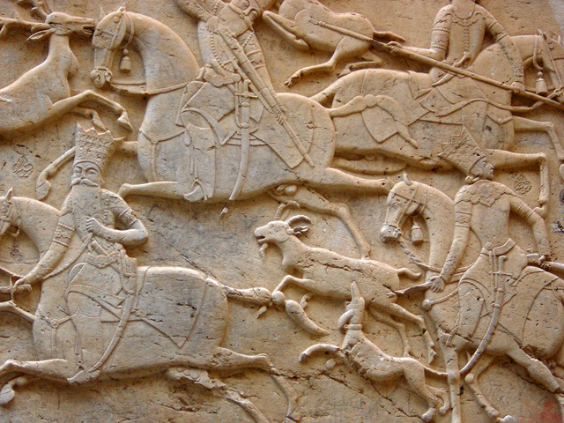
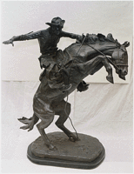
What is a Relief?
http://en.wikipedia.org/wiki/Relief_sculpture
A relief is a ‘flat’ sculpture. It can be carved, cast, or built up. It is different than sculpture in the round, which looks different from every angle. The back of a relief is flat.
Relief sculpture
Sculpture in the round

Slide 3
We are going to build up a relief using cardboard, then cover it in foil and add a patina.

Slide 4
Materials
Light cardboard in two colors
Heavy cardboard for plate
Pencils/erasers
Scissors
Glue stick
Hole punch
Foil
Spray glue
Permanent chisel-tip black marker (like Marks-a-Lot)
Steel wool (fine grade 00 or 000)
Gallon-size storage bag (Ziploc) for storage between sessions

Slide 5
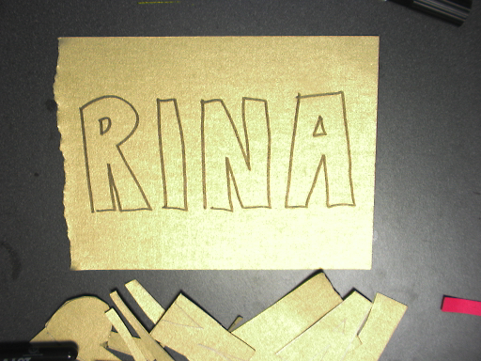
Draw your name in block letters on the gold paper
Can do bubble letters
Can do name, nickname or initials
Hebrew, Arabic, Chinese, Korean etc. name OK!

Slide 6
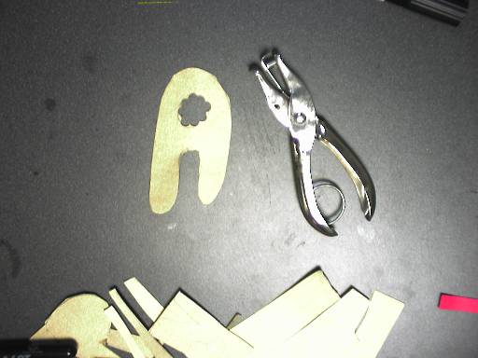
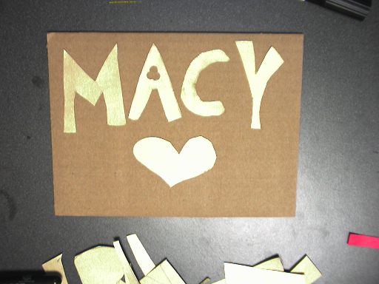
Cut out gold letters and glue down on cardboard plate
You can use a hole punch to get the small areas inside letters

Slide 7
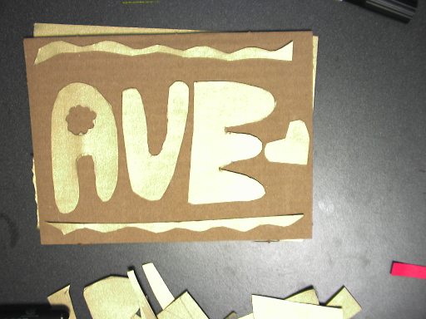
Use scraps of gold paper to make decoration or border
You can make hearts, stars…
Your birthdate or player number

Slide 8
Add a second layer using red paper
Day 1
Day 2

Slide 9
Layer 1: gold Layer 2: red OVERLAP gold

Slide 10
Look at the corners!

Slide 11
Go outside. Cover table with newspaper. Spray front of art with glue.

Slide 12
Put art face down on foil. Fold edges back.

Slide 13
Carefully rub with fingers.
Next rub with flat side of popsicle stick, or roll marker over your art.

Slide 14
Add a Patina
What is a patina?
http://en.wikipedia.org/wiki/Patina
A change in the art’s color and texture. It can build up over time (e.g. rusty old iron) or it can be applied with color or chemicals.

Slide 15
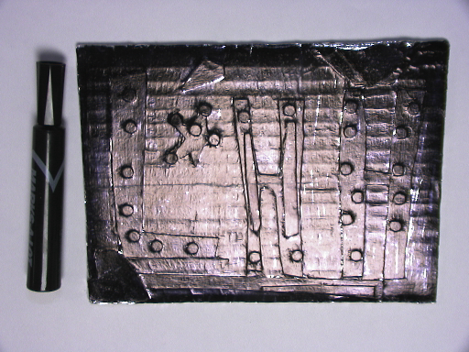
Cover your art with black marker
Cover front of foil with marker completely
(edge to edge)
Do not scribble.

Slide 16
Rub with steel wool. Rub all over the art in a circular motion.

Slide 17
Foil art before and after applying patina
After patina
Before patina

Slide 18
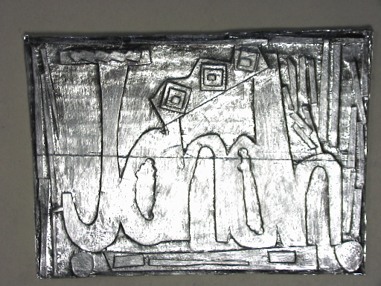
Grace /Jonah

Slide 19
Bianca

